Slide 1


Data Science/Machine Learning
Copyright © www.ITbodhi.com

Slide 2

Copyright © www.ITbodhi.com

Slide 3
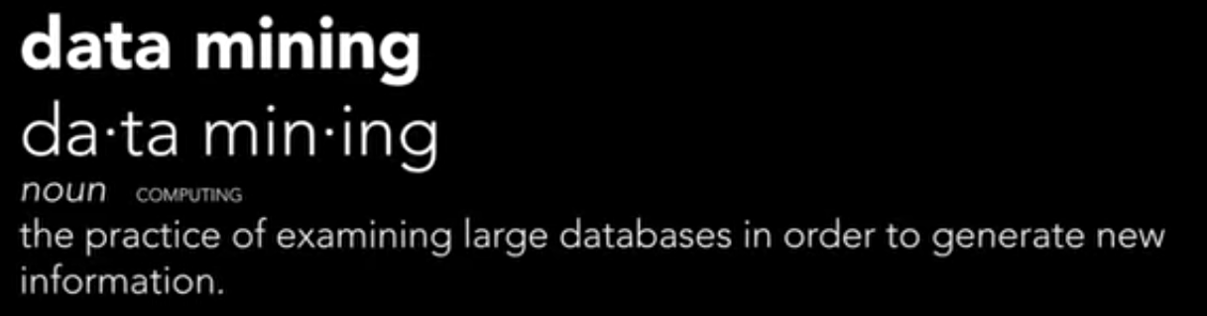
Copyright © www.ITbodhi.com

Slide 4

Copyright © www.ITbodhi.com

Slide 5

Copyright © www.ITbodhi.com

Slide 6
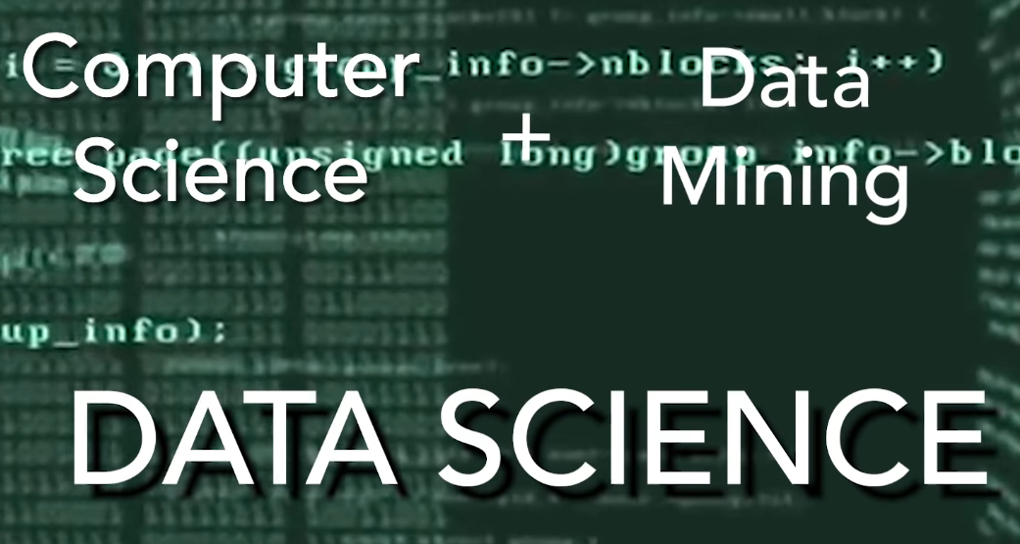
Copyright © www.ITbodhi.com

Slide 7

Copyright © www.ITbodhi.com

Slide 8

Copyright © www.ITbodhi.com

Slide 9

Copyright © www.ITbodhi.com

Slide 10

Copyright © www.ITbodhi.com

Slide 11
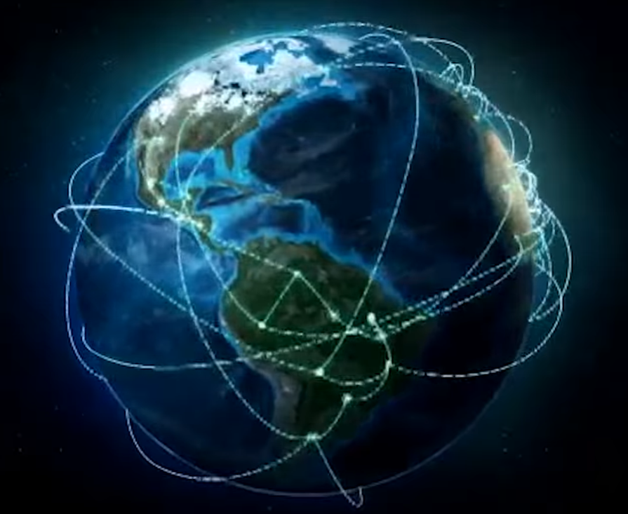
Copyright © www.ITbodhi.com

Slide 12
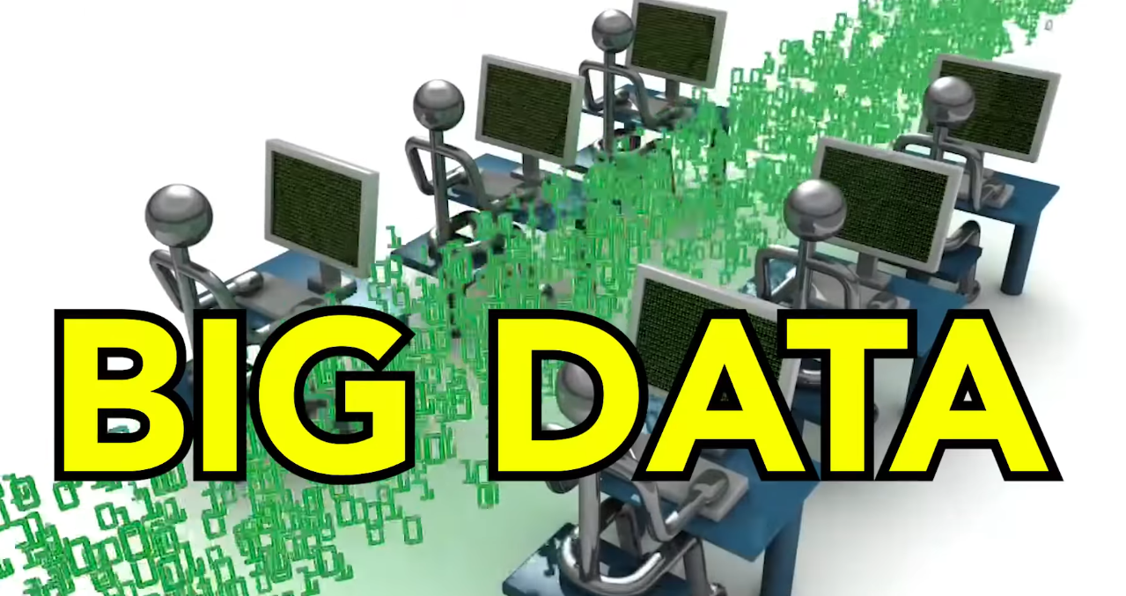
Copyright © www.ITbodhi.com

Slide 13
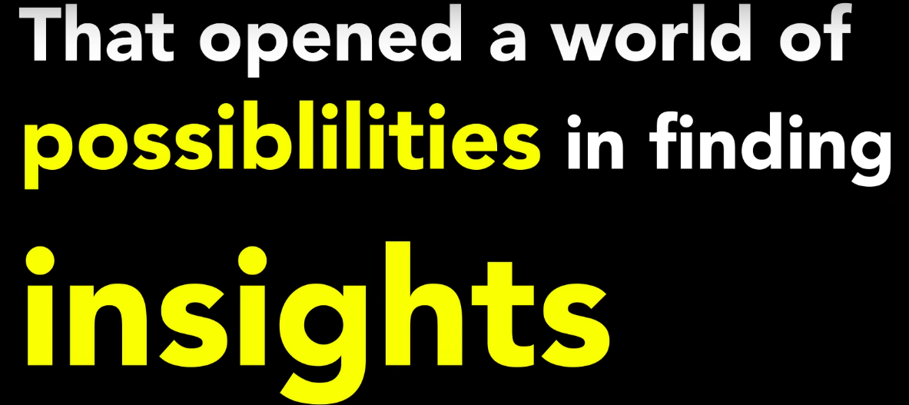
Copyright © www.ITbodhi.com

Slide 14
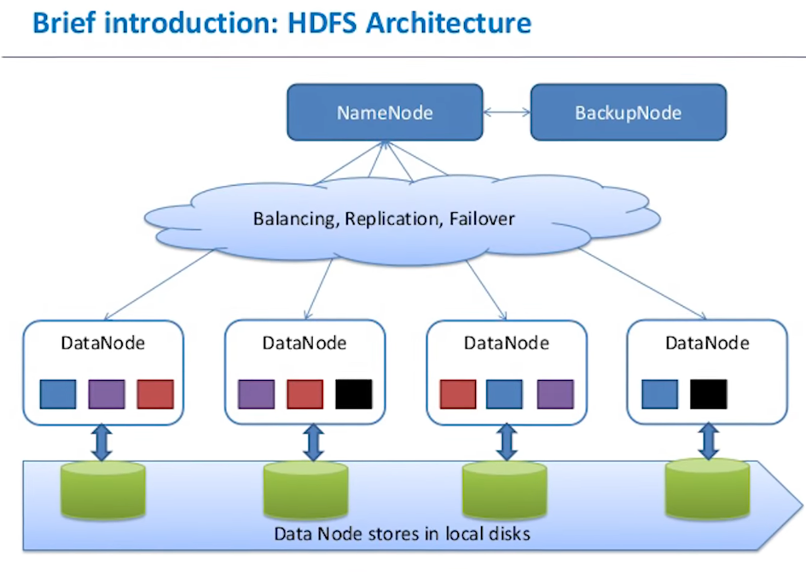
Copyright © www.ITbodhi.com

Slide 15
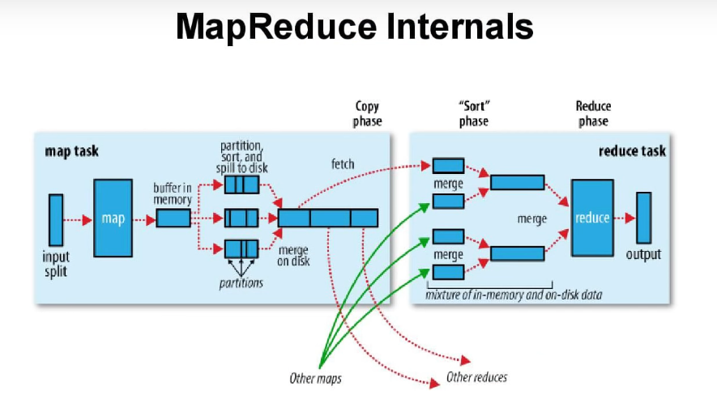
Copyright © www.ITbodhi.com

Slide 16

Copyright © www.ITbodhi.com

Slide 17

Copyright © www.ITbodhi.com

Slide 18
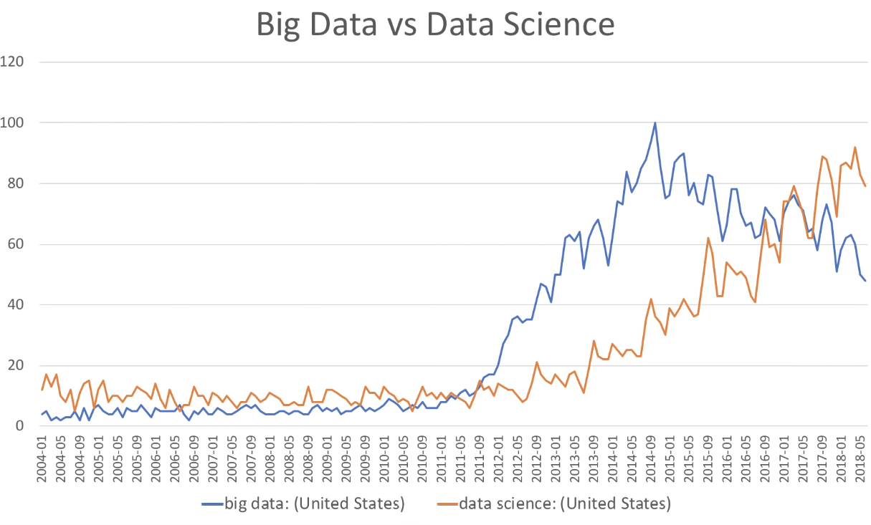
Copyright © www.ITbodhi.com

Slide 19
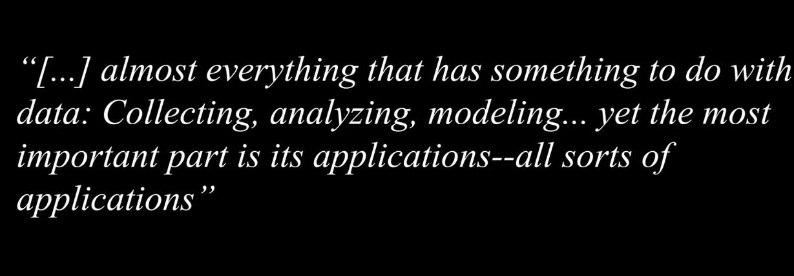
Copyright © www.ITbodhi.com

Slide 20

Copyright © www.ITbodhi.com

Slide 21
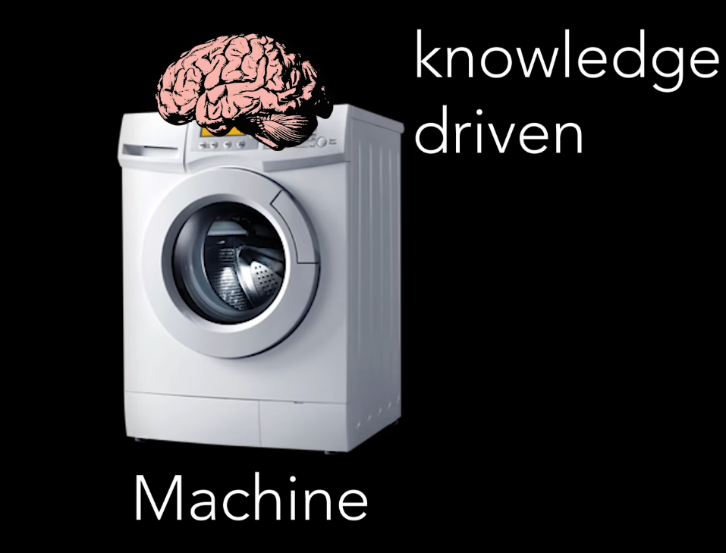
Copyright © www.ITbodhi.com

Slide 22
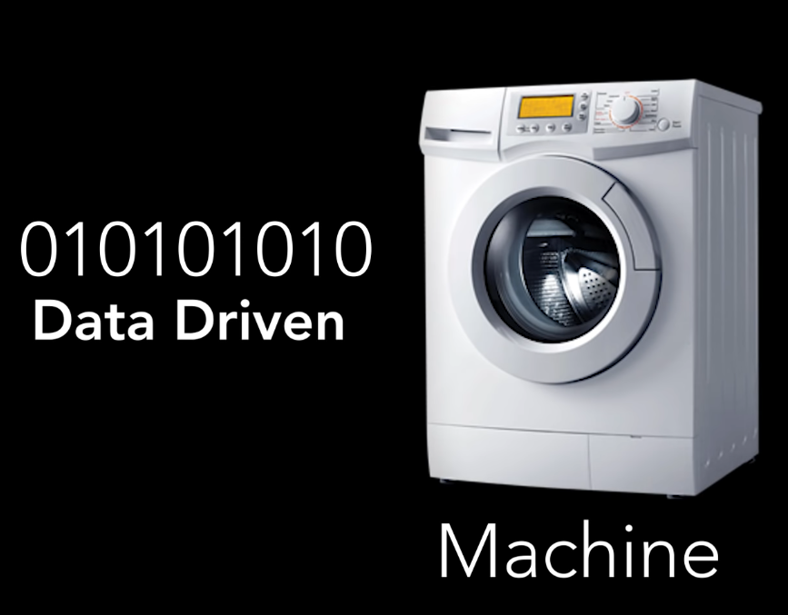
Copyright © www.ITbodhi.com
Notes:
Now Machine Learning, Deep Learning was no longer academic concept but come to real life

Slide 23
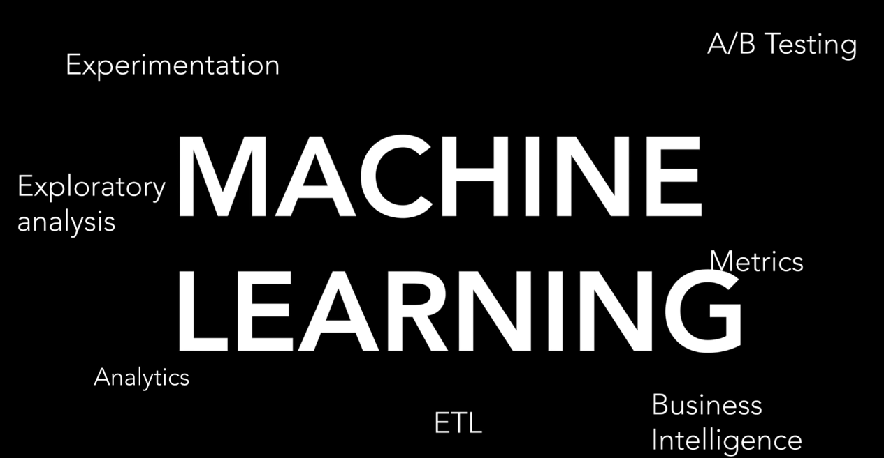
Copyright © www.ITbodhi.com
Notes:
Now Machine Learning, Deep Learning was no longer academic concept but come to real life

Slide 24
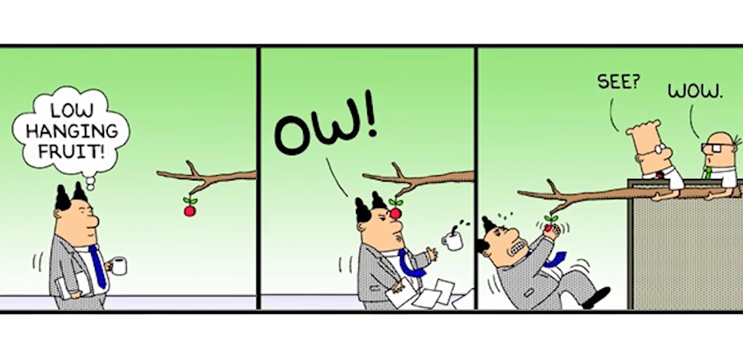
Copyright © www.ITbodhi.com
Notes:
So many low hanging fruit and no longer require PhD in Mathemeatics or in statistics

Slide 25
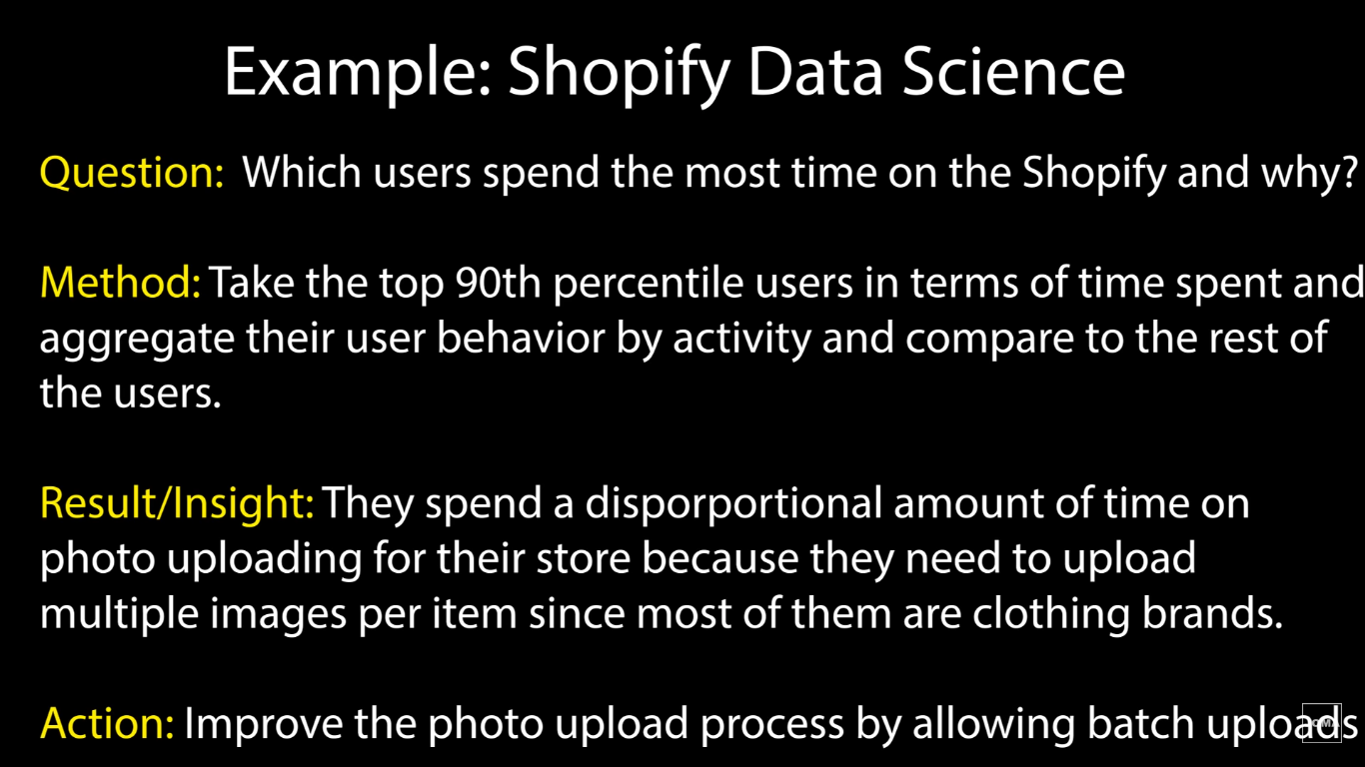
Copyright © www.ITbodhi.com
Notes:
So many low hanging fruit and no longer require PhD in Mathemeatics or in statistics

Slide 26
Copyright © www.ITbodhi.com
Notes:
So many low hanging fruit and no longer require PhD in Mathemeatics or in statistics

Slide 27

Copyright © www.ITbodhi.com
Notes:
So many low hanging fruit and no longer require PhD in Mathemeatics or in statistics

Slide 28

Copyright © www.ITbodhi.com
Notes:
This is about not making complex models but IMPACT

Slide 29

Copyright © www.ITbodhi.com
Notes:
This is about not making complex models but IMPACT

Slide 30
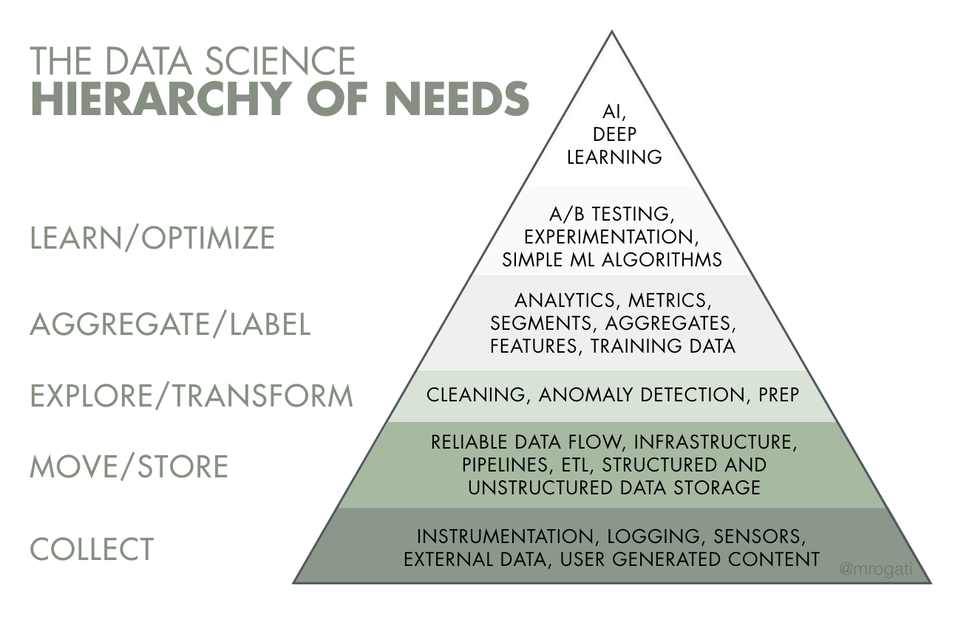
Copyright © www.ITbodhi.com
Notes:
This is about not making complex models but IMPACT

Slide 31
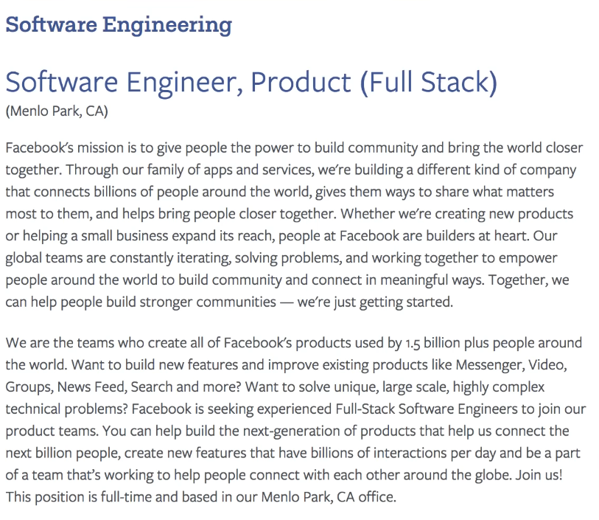
Copyright © www.ITbodhi.com
Notes:
This is about not making complex models but IMPACT

Slide 32
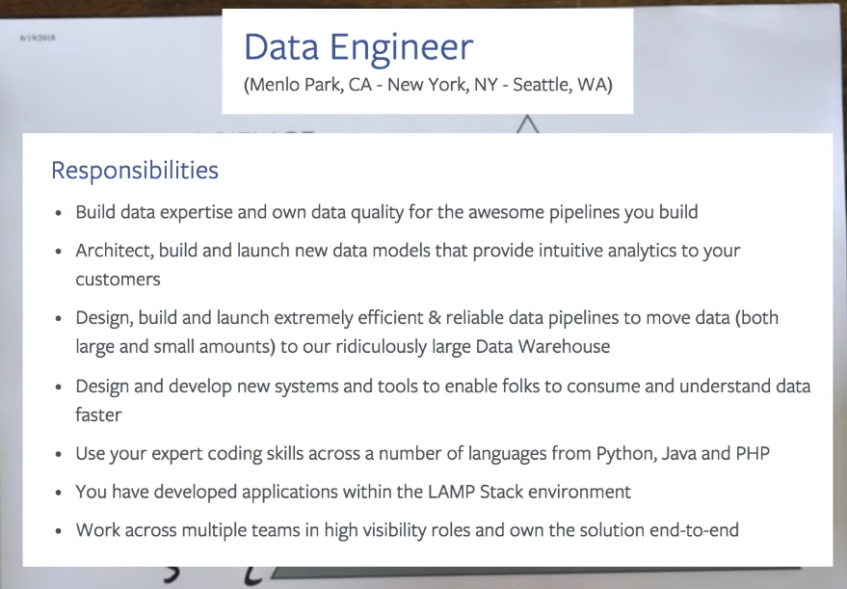
Copyright © www.ITbodhi.com
Notes:
This is about not making complex models but IMPACT

Slide 33
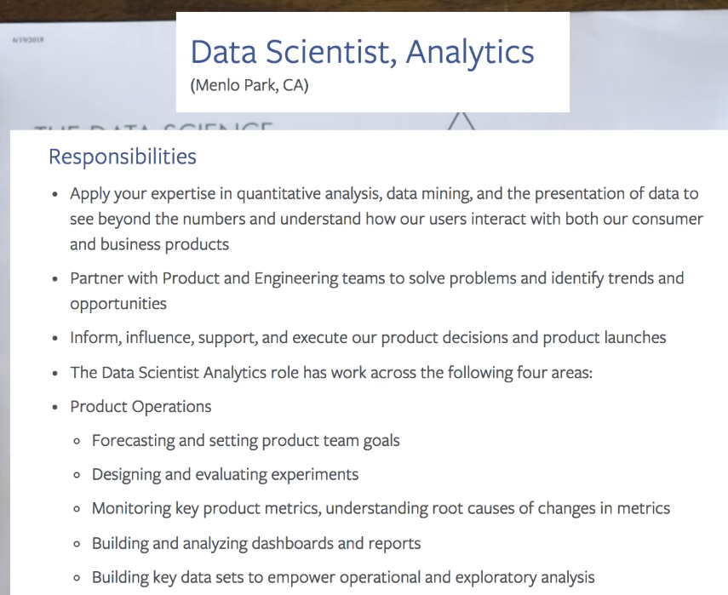
Copyright © www.ITbodhi.com
Notes:
This is about not making complex models but IMPACT

Slide 34
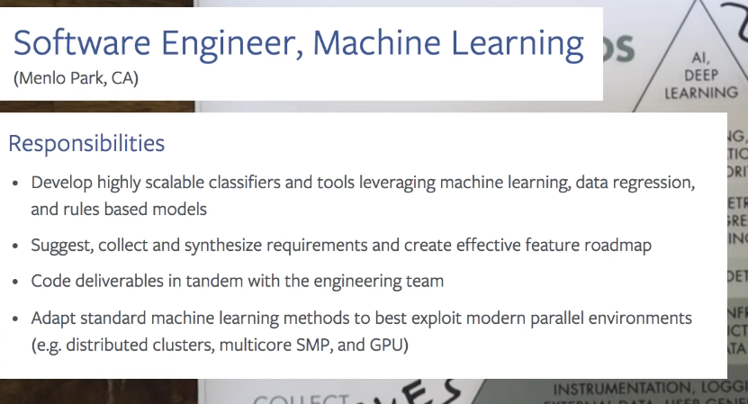
Copyright © www.ITbodhi.com
Notes:
This is about not making complex models but IMPACT

Slide 35
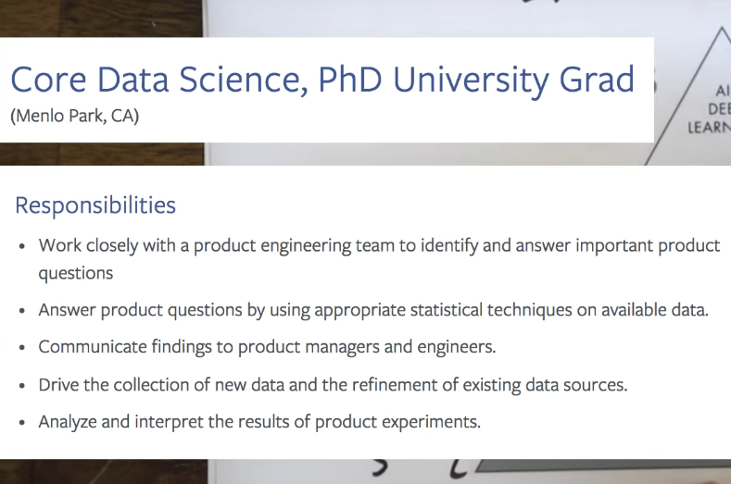
Copyright © www.ITbodhi.com
Notes:
This is about not making complex models but IMPACT

Slide 36
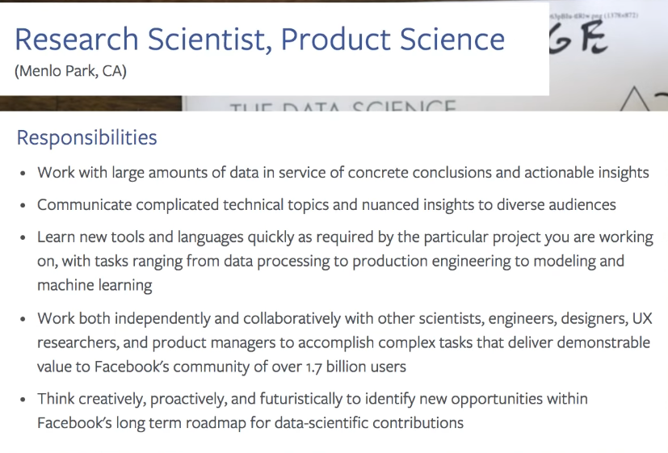
Copyright © www.ITbodhi.com
Notes:
This is about not making complex models but IMPACT

Slide 37
How to become a Data Scientist
Copyright © www.ITbodhi.com
Notes:
This is about not making complex models but IMPACT

Slide 38
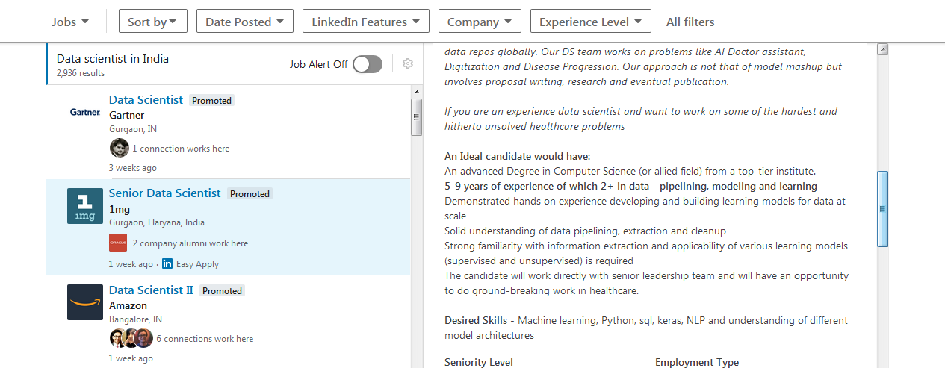
Copyright © www.ITbodhi.com
Notes:
This is about not making complex models but IMPACT

Slide 39
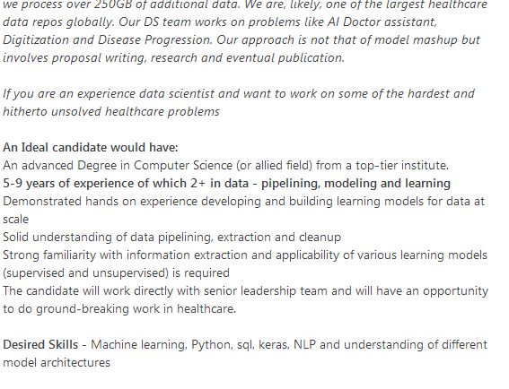
Copyright © www.ITbodhi.com
Notes:
1 MG data sceintiest

Slide 40
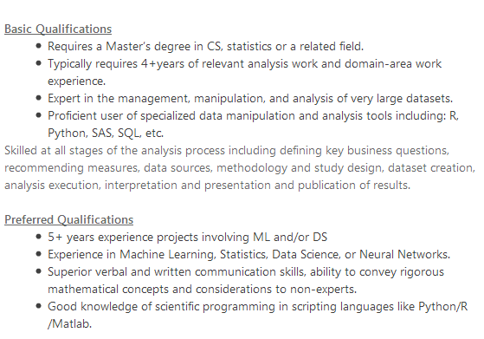
Copyright © www.ITbodhi.com
Notes:
Amazon Tier 2 data scientist

Slide 41

Copyright © www.ITbodhi.com
Notes:
Amazon Tier 2 data scientist

Slide 42

Copyright © www.ITbodhi.com
Notes:
Amazon Tier 2 data scientist

Slide 43


Copyright © www.ITbodhi.com
Notes:
Amazon Tier 2 data scientist

Slide 44
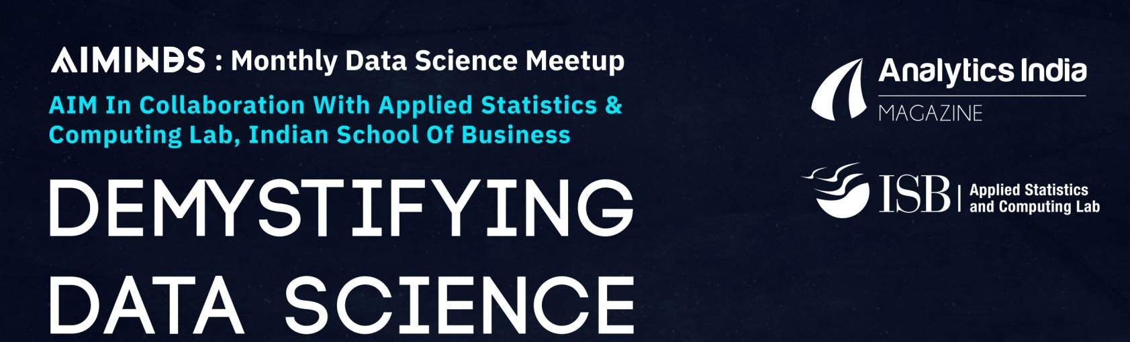
Copyright © www.ITbodhi.com
Notes:
Amazon Tier 2 data scientist

Slide 45
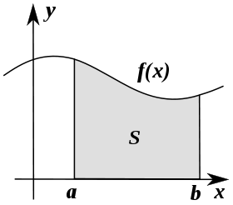


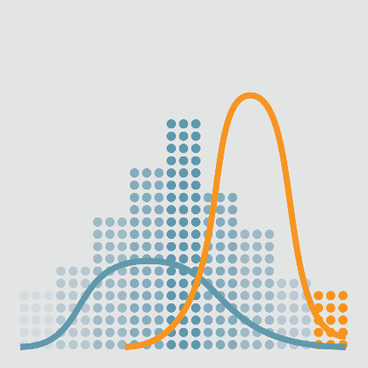

Course Curriculum
Machine Learning Foundations:
Mathematics behind Machine Learning
Linear Algebra
Functions and Graphs
Calculus
Introduction to Probability Theory
Statistics and its Applications
Python
Copyright © www.ITbodhi.com

Slide 46
Supervised Learning
Introduction to Supervised Learning
Linear Regression
Logistic Regression
Decision Trees/Random Forests
Naïve Bayes Classifier
Bayesian Statistics and Inference
K-Nearest Neighbor
SVM
Unsupervised Learning
Introduction to Unsupervised Learning
K-Means Clustering
Hierarchal Clustering
Clustering Mini-Project
Getting Started with Machine Learning
What is Machine Learning
Numpy, Pandas, Scikit, Metlpotlib
Model Evaluation and Validation
Training and Testing
Metrics for Evaluation
Hyperparameters Tuning & Model Optimization
Data Exploration & Feature Engineering
Data Wrangling
Data Pre-prcocessing
Feature Selection
Principal Components Analysis (PCA)
Feature Transformations
Copyright © www.ITbodhi.com

Slide 47
Amazon Web Services
IAM/S3/EC2
Machine Learning on AWS
Dimensionality Reduction
PCA/LDA
Kernel PCA
SMOTE
Model Selection & Boosting
k-fold Cross Validation,
Outlier detection, Parameter Tuning
Grid Search
GBM/XGBoost/LightGBM
Natural Language Processing
Introduction to Natural language Processing
Regular Expressions in Python
Tokenization
Topic Modeling
Deep Learning
Introduction to Neural Netowrks
TensorFlow / Theano / Keras
Deep Neural networks
Computer Vision
Convolutional Neural Networks CNN
Recurrent Neural Network RNN
Long Short Term Memory(LSTM)/GRU
Deep Learning Projects covered during the course
Sentiment Analysis
Image classification
Handwritten digits recognition
Chatbot from scratch
Named Entity Recognition
Movie Rating
Image Recognition & Classification
Copyright © www.ITbodhi.com

Slide 48
Case Studies & Industry Project
Duration 2 Months
Data Science competitions on Kaggle/Hakerearth etc.
Interviews Preparation
Hackathon
BootCamp
Copyright © www.ITbodhi.com

Slide 49
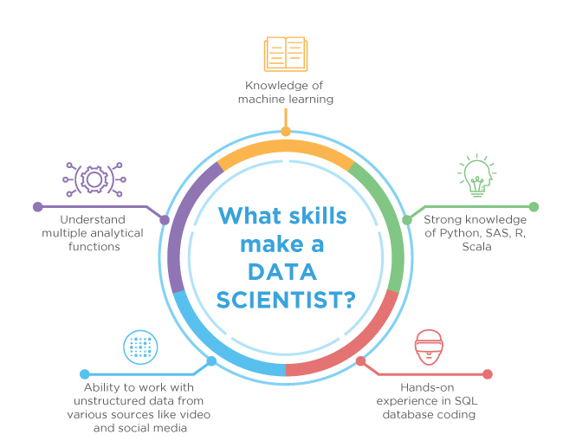
Skills to become a Data Scientist
Copyright © www.ITbodhi.com

Slide 50
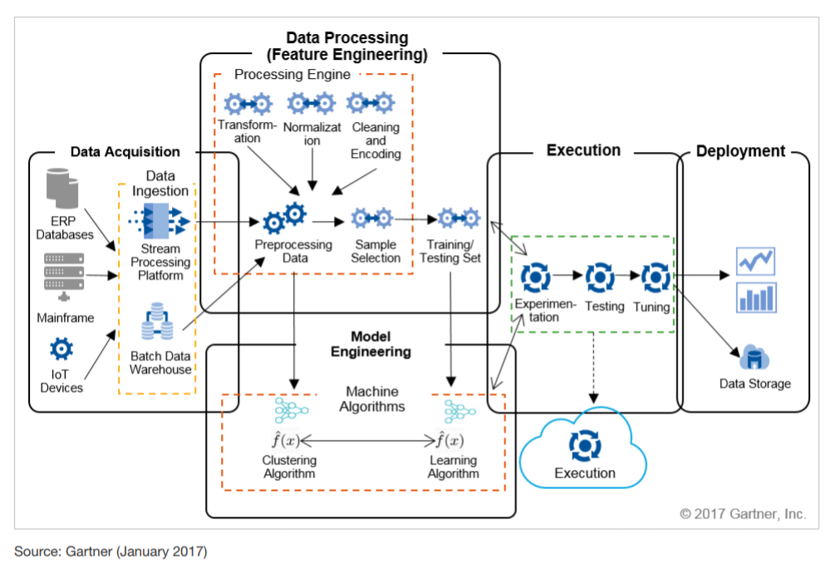
Architecture
Copyright © www.ITbodhi.com

Slide 51
ML Buzz word ! Suddenly ?
Huge data in digital form
Computational capability
Recent progress in algorithms and theory
Copyright © www.ITbodhi.com

Slide 52
Machine Learning Applications
Computer vision
Image Classification
Facial recognition technology
Optical character recognition
Natural language Processing
Language Translation
Spell check
Autocomplete
Voice text messaging
Spam filters
Related keywords on search engines
Siri, Alexa, or Google Assistant
Recommendation engines
Self-driving cars
News classification
Sensor Networks
Predictive maintenance
SPAM classification
Medical diagnosis
Credit scoring
Fraud detection
Market segmentation
Google page ranking
Collaborative filtering
Named entity recognition
Copyright © www.ITbodhi.com

Slide 53

What is Machine Learning?
Copyright © www.ITbodhi.com

Slide 54

Machine Learning is.. Field of study that gives computers the ability to learn without being explicitly programmed. ~ Arthur Samuel‘ 1959
Copyright © www.ITbodhi.com

Slide 55
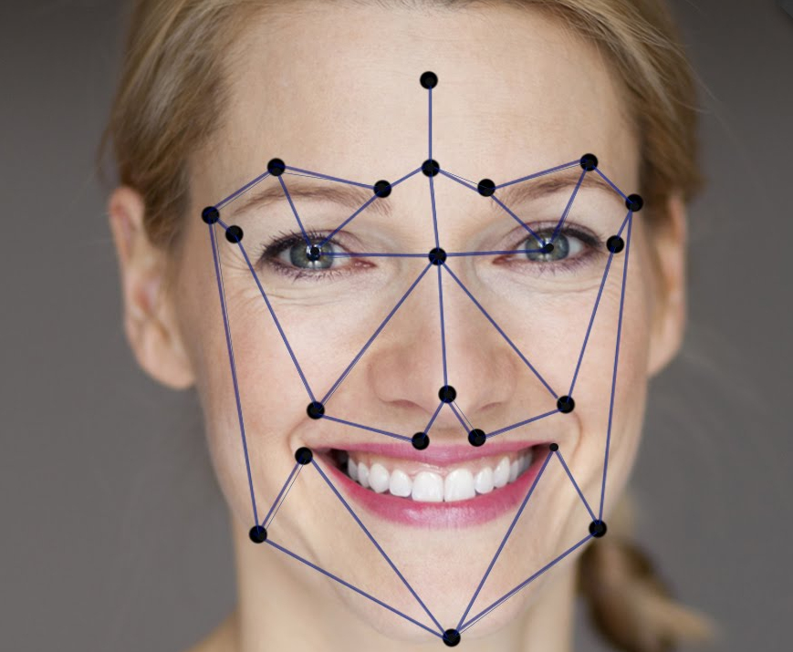
Solve complex problems where conventional machines fails to give good results.
Copyright © www.ITbodhi.com

Slide 56

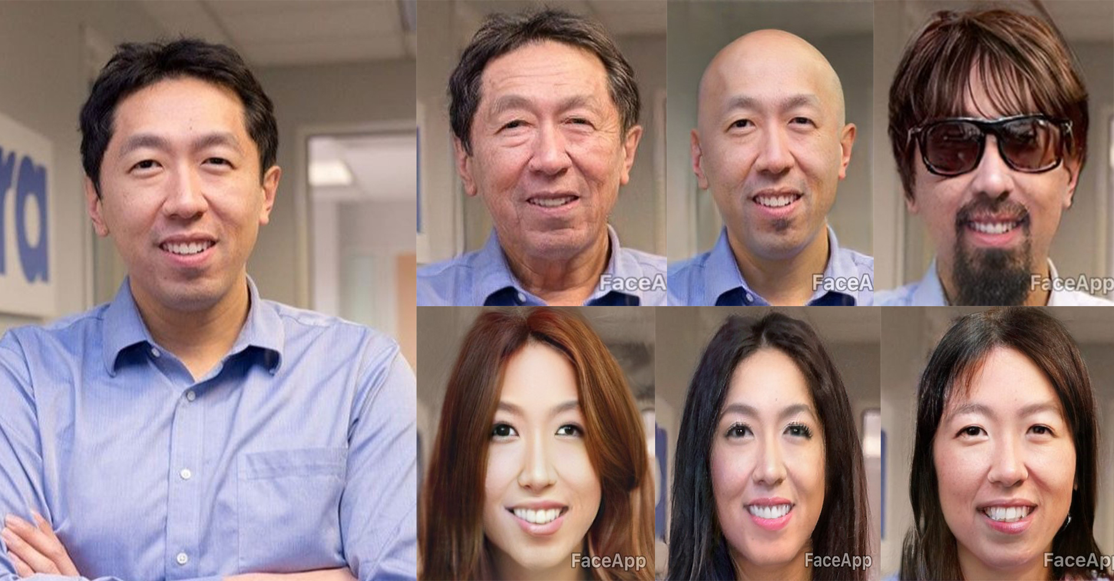
Machine Learning Applications : FaceApp
Copyright © www.ITbodhi.com

Slide 57
Machine Learning
Machine Learning is the name given to generalizable algorithms that enable a computer to carry out a task by examining data rather than hard programming.
Subfield of computer science and artificial intelligence
Learn from data and help in making decisions and predictions based on that learning.
Data-driven decisions rather than being explicitly programmed to carry out a certain task.
Math provides models; understand their relationships and apply them to real-world objects.
Copyright © www.ITbodhi.com

Slide 58

Copyright © www.ITbodhi.com

Slide 59
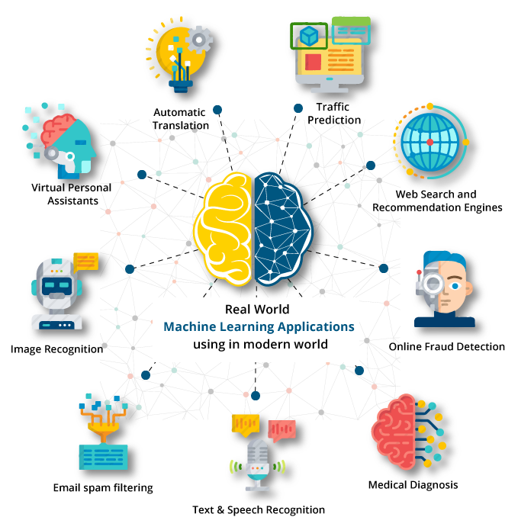
Copyright © www.ITbodhi.com

Slide 60
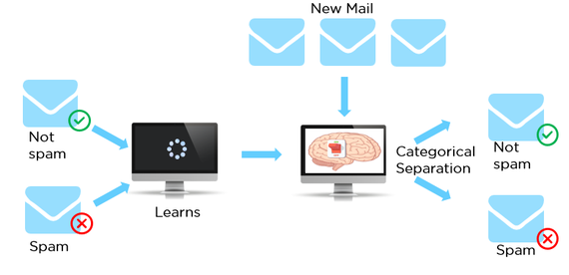
Spam Filtering using Machine Learning
Copyright © www.ITbodhi.com

Slide 61
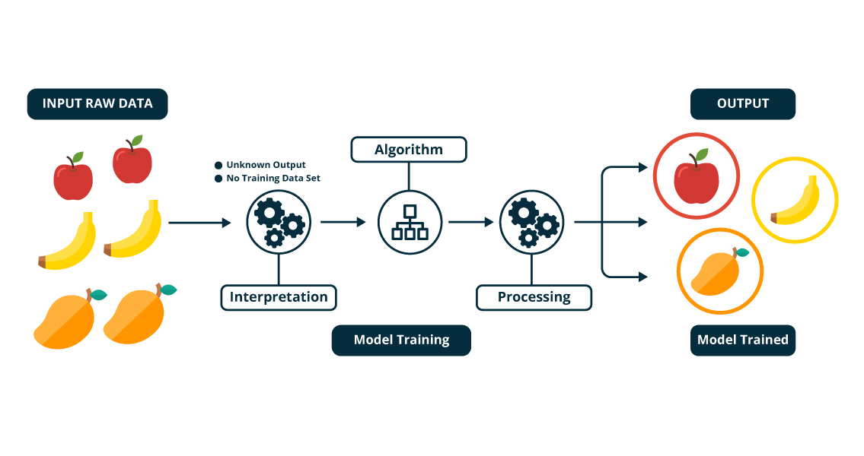
Copyright © www.ITbodhi.com

Slide 62
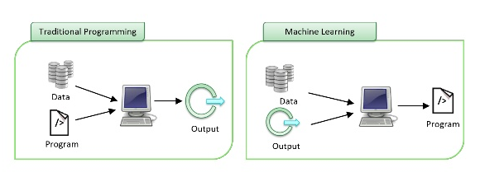
Traditional Programming VS Machine Learning
Copyright © www.ITbodhi.com

Slide 63
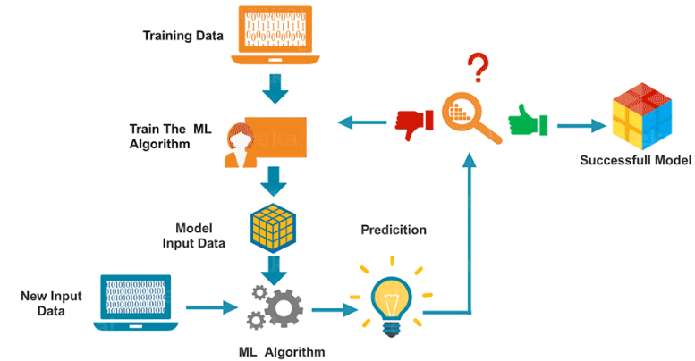
Machine Learning Process
Copyright © www.ITbodhi.com

Slide 64
Can Machine Learning be applied everywhere?
Deterministic Problems
These are the set of problems which have a pre-defined set of steps which solve them, every time.
Rules driven
Non-Deterministic Problems
Either we don’t know enough about the problem or we don’t have enough computing power to model the problem.
Human expertise does not exist or Humans are unable to explain their expertise (speech recognition)
Data driven
Machine Learning is an approach which uses data to identify patterns (learning) and solves the problem based on this learning. As new data comes in, the machine learning algorithm adjusts itself based on the data and start giving out results as per the new learning.
Copyright © www.ITbodhi.com

Slide 65
Jargons..
Statistics is just about the numbers, and quantifying the data. There are many tools for finding relevant properties of the data but this is pretty close to pure mathematics.
Data Mining is about using Statistics as well as other programming methods to find patterns hidden in the data so that you can explain some phenomenon. Data Mining builds intuition about what is really happening in some data and is still little more towards math than programming, but uses both.
Machine Learning uses Data Mining techniques and other learning algorithms to build models of what is happening behind some data so that it can predict future outcomes. It’s a particular approach to AI.
Deep Learning is one type of Machine Learning that achieves great power and flexibility by learning to represent the world as nested hierarchy of concepts, with each concept defined in relation to simpler concepts, and more abstract representations computed in terms of less abstract ones
Artificial Intelligence uses models built by Machine Learning and other ways to reason about the world and give rise to intelligent behavior whether this is playing a game or driving a robot/car. Artificial Intelligence has some goal to achieve by predicting how actions will affect the model of the world and chooses the actions that will best achieve that goal. Very programming based.
Copyright © www.ITbodhi.com

Slide 66
AI, ML & DL
Artificial Intelligence
Narrow AI
General Intelligence
Machine Learning
Data Mining
NLP
Deep Learning
Image Processing
Voice Recognition
Copyright © www.ITbodhi.com

Slide 67
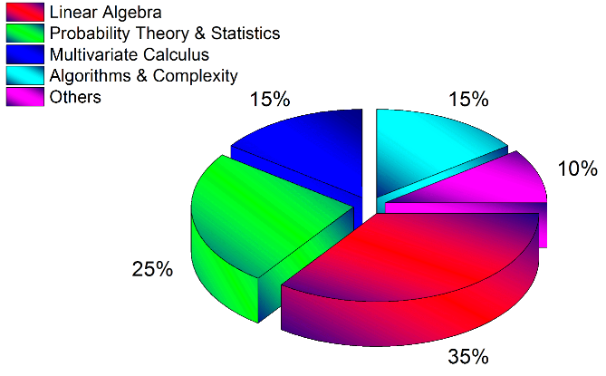
Mathematics makes the difference !!
Copyright © www.ITbodhi.com

Slide 68
Foundation of Machine Learning
Role of Statistics: Statistics is a subfield of mathematics. We need statistics to help transform observations into information and to answer questions about samples of observations. in order to both understand the data used to train a machine learning model and to interpret the results of testing different machine learning models, that statistical methods are required.
Role of Computer science: Efficient algorithms to
Solve the optimization problem
Representing and evaluating the model for inference
Role of Mathematics: To build Mathematical model to solve the problem in efficient manner over which computer algorithms are designed.
Linear algebra : is a sub-field of mathematics concerned with vectors, matrices, and linear transforms. It is a key foundation to the field of machine learning, from notations used to describe the operation of algorithms to the implementation of algorithms in code.
Calculus: Machine learning uses derivatives in optimization problems. Optimization algorithms like gradient descent use derivatives to decide whether to increase or decrease weights in order to maximize or minimize some objective.
Probability Theory: Probability theory is a mathematical framework for quantifying uncertainty about the world. It allows us (and our software) to reason effectively in situations where being certain is impossible. Probability theory is at the foundation of many machine learning algorithms.
Copyright © www.ITbodhi.com

Slide 69
Data Science VS Machine Learning
Machine learning and statistics are part of data science and data science is much more than machine learning.
Data, in data science, may or may not come from a machine or mechanical process (survey data could be manually collected, clinical trials involve a specific type of small data) and it might have nothing to do with learning.
But the main difference is the fact that data science covers the whole spectrum of data processing, not just the algorithmic or statistical aspects.
In particular, data science also covers
data integration
distributed architecture
automating machine learning
data visualization
dashboards and BI
data engineering
deployment in production mode
automated, data-driven decisions
In many organizations, data scientists focus on only one part of this process
Copyright © www.ITbodhi.com

Slide 70
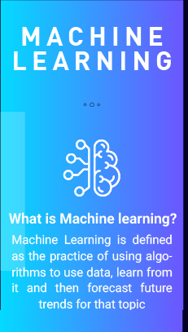
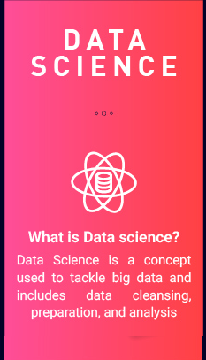
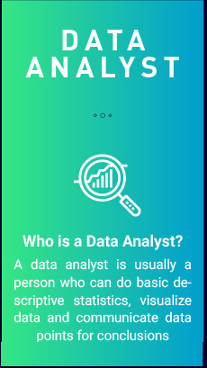
Copyright © www.ITbodhi.com

Slide 71
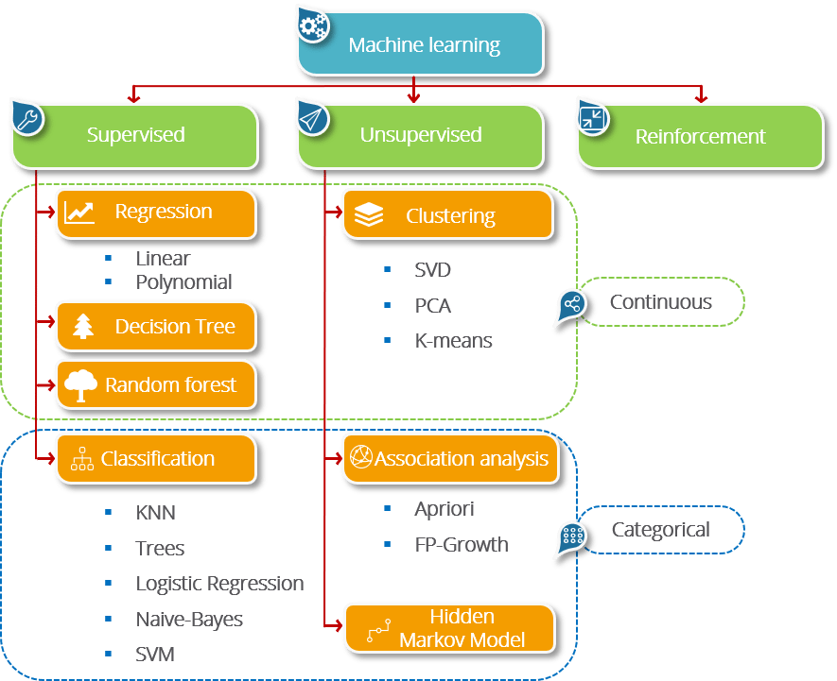
Types
Machine Learning
Copyright © www.ITbodhi.com

Slide 72
Supervised Learning
The purpose is to predict the value of a particular variable(target variable) based on values of some other variables(independent or explanatory variables).
Classification is used to predict the value of a discrete target variable while regression is used to predict the value of a continuous target variable.
To predict whether an email is spam or not is a Classification task while to predict the future price of a stock is a regression task.
They are called supervised because we are telling the algorithm what to predict.
E.g. Speech recognition, Spam classification, Fraud detection, Medical diagnosis, Face detection, Character Recognition, Speech Recognition, Weather Forecast etc.
Copyright © www.ITbodhi.com

Slide 73
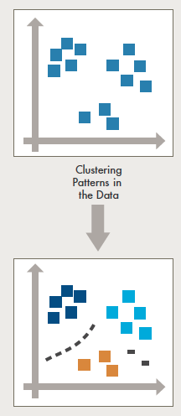
Unsupervised Learning
The purpose is to derive patterns that summarize the underlying relationships in data.
Association Analysis, Cluster Analysis and Anomaly detection are examples of Unsupervised Learning.
They are called unsupervised because in such cases, the final outcome is not known beforehand.
Example: Customer segmentation, Visual Recognition, predicting or understanding handwritten digits, clustering websites based on particular words count on each webpage
Copyright © www.ITbodhi.com

Slide 74
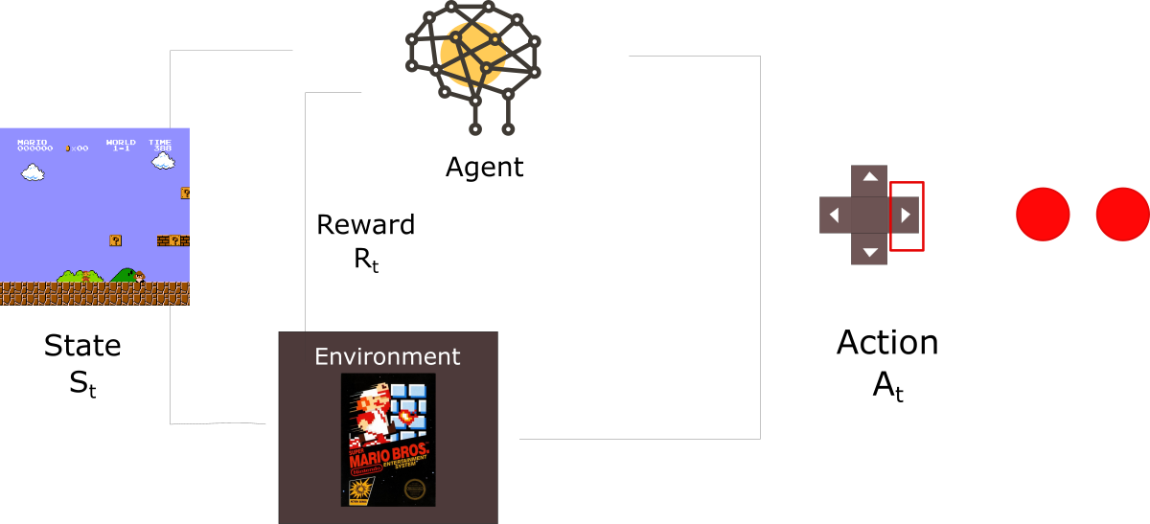
Reinforcement Learning
Reinforcement Learning
Reinforcement Learning allows the machine or software agent to learn its behavior based on feedback from the environment.
Learning a policy: A sequence of outputs
No supervised output but delayed reward
Game playing,Self Driving Cars, Gaming, Robotics
Let’s imagine an agent learning to play Super Mario Bros as a working example.
Copyright © www.ITbodhi.com

Slide 75
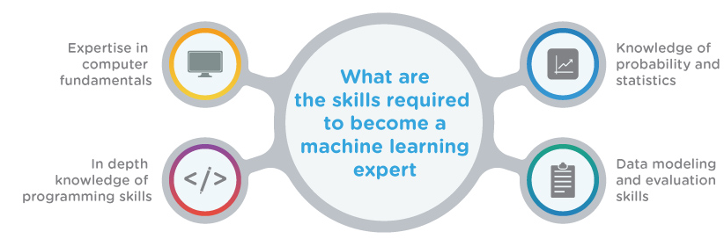
Skills to become a ML engineer
Copyright © www.ITbodhi.com

Slide 76

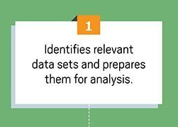
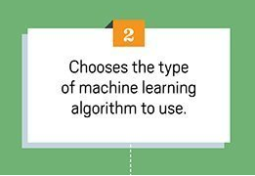
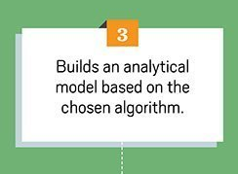
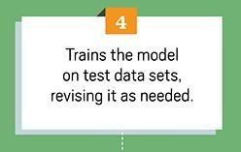
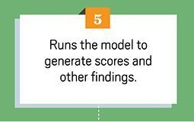
Copyright © www.ITbodhi.com

Slide 77
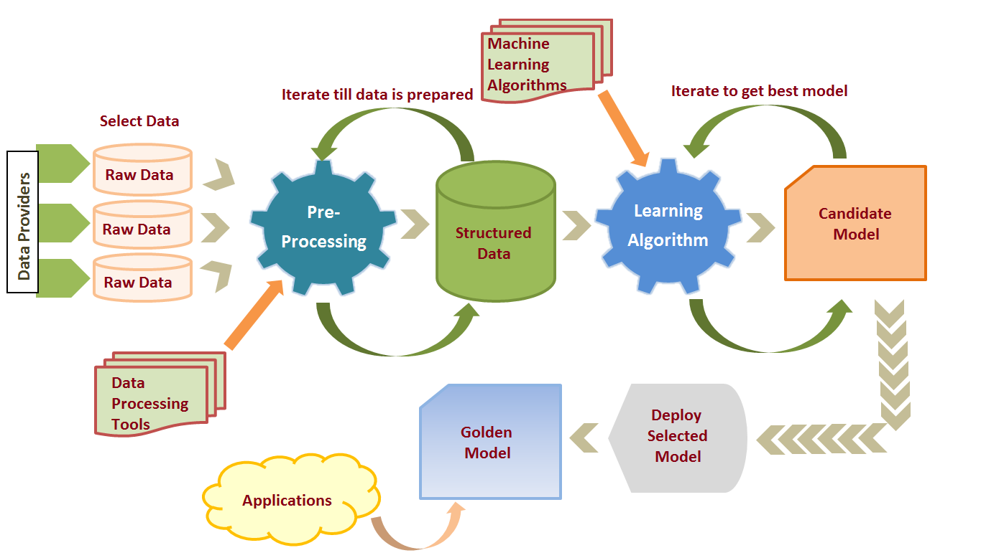
ML Life Cycle
Copyright © www.ITbodhi.com

Slide 78

ML Effort Distribution
Copyright © www.ITbodhi.com

Slide 79

Copyright © www.ITbodhi.com

Slide 80
Ps of Machine Learning
Probability
Passion
Patience
Copyright © www.ITbodhi.com

Slide 81
End to end architecture
DataFlow
NiFi
Analytics
Sci-Kit
Tensor Flow
AWS-ML
Spark
Machine Learning
Batch data loading
Sqoop
HADOOP – Data Storage
Traceability data
Change Management
Customer Complaint
Real time data loading
Die Fabrication data
Wafer Electrical data
Product Information
Kafka
Storm
Sort Electrical Test data
Final Electrical Test Data
Etc…
Flume
Copyright © www.ITbodhi.com

